Slide 1



Twitter Sentiment analysis
S.SRISAI
G. VINEETH
CH. HARI KRISHNA
E. SAI CHARAN K. NETHA

Slide 2
This project addresses the problem of sentiment analysis in twitter; that is classifying tweets according to the sentiment expressed in them: positive, negative or neutral. Twitter is an online micro-blogging and social-networking platform which allows users to write short status updates of maximum length 140 characters. It is a rapidly expanding service with over 200 million registered users - out of which 100 million are active users and half of them log on twitter on a daily basis - generating nearly 250 million tweets per day . Due to this large amount of usage we hope to achieve a reflection of public sentiment by analyzing the sentiments expressed in the tweets. Analyzing the public sentiment is important for many applications such as firms trying to find out the response of their products in the market, predicting political elections and predicting socioeconomic phenomena like stock exchange. The aim of this project is to develop a functional classifier for accurate and automatic sentiment classification of an unknown tweet stream.
This project addresses the problem of sentiment analysis in twitter;
ABSTRACT

Slide 3

Problem statement
Formally, we train sample of tweets and labels, where label ‘1’ denotes the tweet is racist/sexist and label ‘0’ denotes the tweet is not racist/sexist, our objective is to predict the labels on the given test dataset.
Note: The evaluation metric from this practice problem is F1-Score.

Slide 4

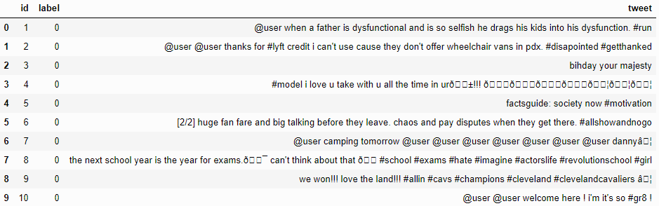
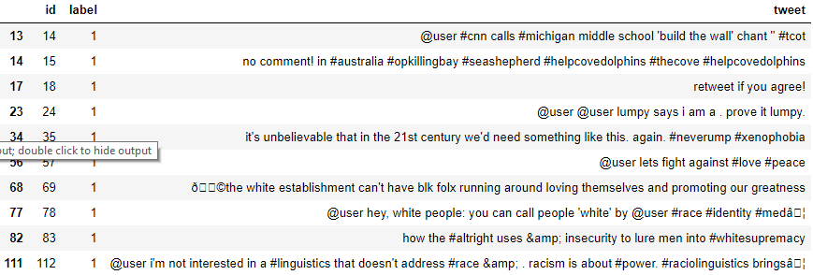
Data inspection
Few non racist/sexist tweets
Few racist/sexist tweets

Slide 5
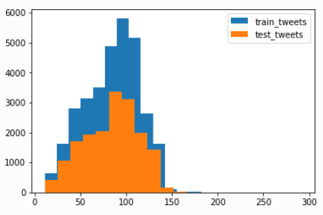
Data inspection
Few non racist/sexist tweets
Few racist/sexist tweets

Slide 6
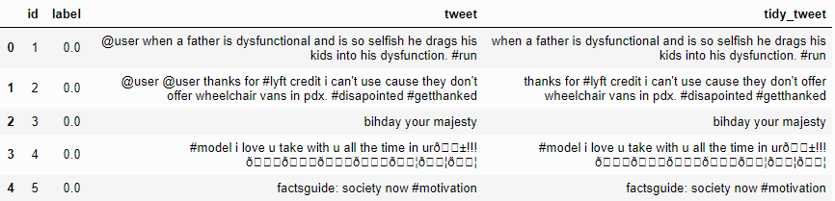
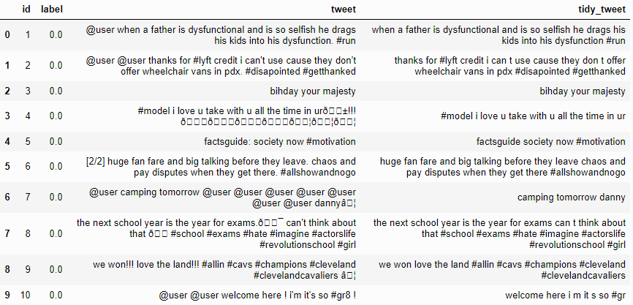
Data Cleaning
Removing Twitter Handles (@user)
Removing Punctuations, Numbers, and Special Characters

Slide 7
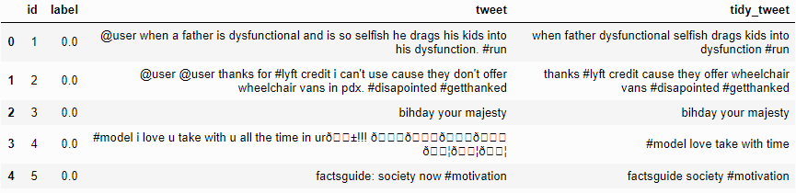
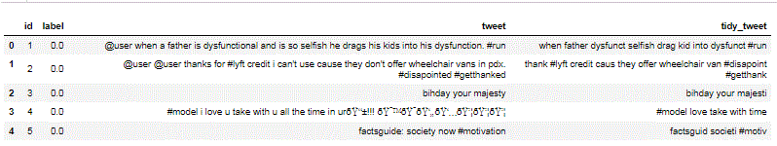
Data Cleaning
3. Removing Short Words
4. Text Normalization

Slide 8
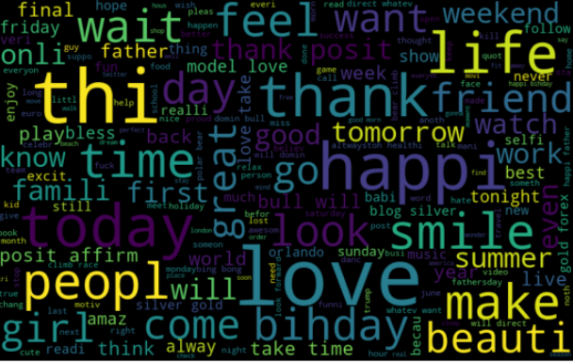
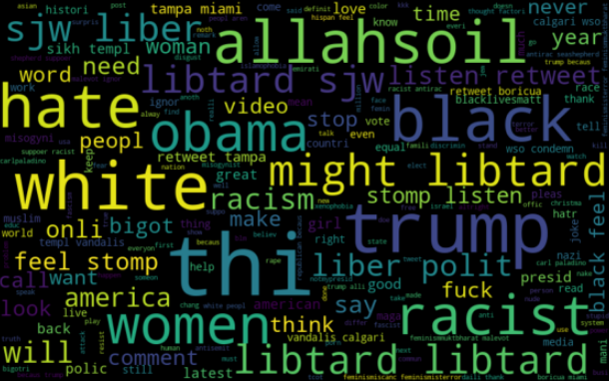
Data Visualization
Non-Racist/Sexist Tweets Racist/Sexist Tweets

Slide 9
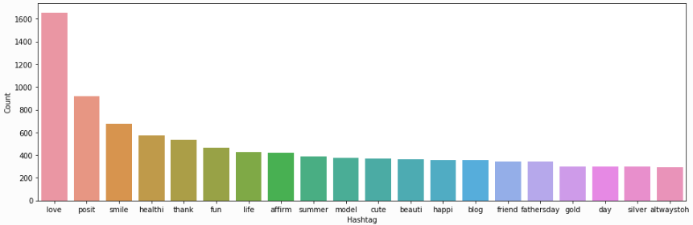
Data Visualization
Non-Racist/Sexist Tweets Racist/Sexist Tweets

Slide 10
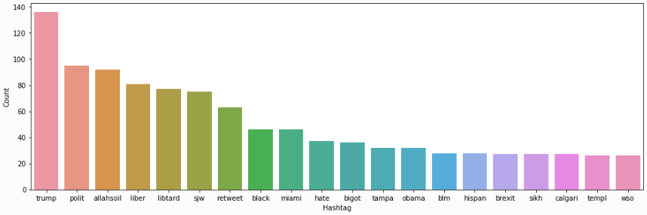
Data Visualization
Non-Racist/Sexist Tweets Racist/Sexist Tweets

Slide 11

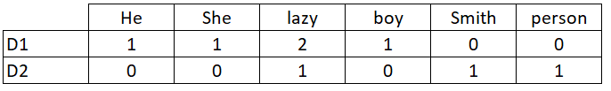
Bag-of-Words Features
Let’s start with the Bag-of-Words Features.
Consider a Corpus C of D documents {d1,d2…..dD} and N unique tokens extracted out of the corpus C. The N tokens (words) will form a dictionary and the size of the bag-of-words matrix M will be given by D X N. Each row in the matrix M contains the frequency of tokens in document D(i).

Slide 12
TF-IDF Features
TF-IDF (term frequency–inverse document frequency)works by penalizing the common words by assigning them lower weights while giving importance to words which are rare in the entire corpus but appear in good numbers in few documents.
Let’s have a look at the important terms related to TF-IDF:
TF = (Number of times term t appears in a document)/(Number of terms in the document)
IDF = log(N/n), where, N is the number of documents and n is the number of documents a term t has appeared in.
TF-IDF = TF*IDF

Slide 13
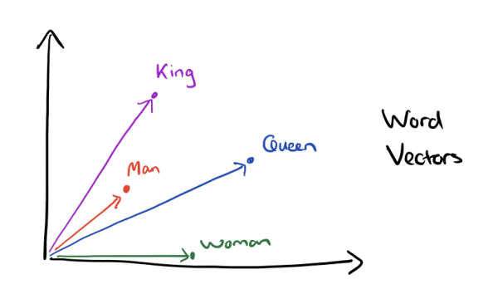
Word2Vec Features
Word embeddings are the modern way of representing words as vectors. The objective of word embeddings is to redefine the high dimensional word features into low dimensional feature vectors by preserving the contextual similarity in the corpus. They are able to achieve tasks like King -man +woman = Queen, which is mind-blowing.
The advantages of using word embeddings over BOW or TF-IDF are:
Dimensionality reduction - significant reduction in the no. of features required to build a model.
It capture meanings of the words, semantic relationships and the different types of contexts they are used in.

Slide 14
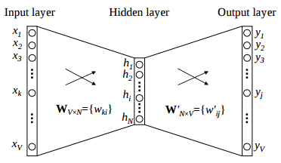
Word2Vec Features
Word2Vec is not a single algorithm but a combination of two techniques – CBOW (Continuous bag of words) and Skip-gram model. Both of these are shallow neural networks which map word(s) to the target variable which is also a word(s). Both of these techniques learn weights which act as word vector representations.
CBOW tends to predict the probability of a word given a context. A context may be a single adjacent word or a group of surrounding words. The Skip-gram model works in the reverse manner, it tries to predict the context for a given word.
Below is a diagrammatic representation of a 1-word context window Word2Vec model.
There are three laters: - an input layer, - a hidden layer, and - an output layer.
The input layer and the output, both are one- hot encoded of size [1 X V], where V is the size of the vocabulary (no. of unique words in the corpus). The output layer is a softmax layer which is used to sum the probabilities obtained in the output layer to 1. The weights learned by the model are then used as the word-vectors.
We will go ahead with the Skip-gram model as it has the following advantages:
It can capture two semantics for a single word. i.e it will have two vector representations of ‘apple’. One for the company Apple and the other for the fruit.
Skip-gram with negative sub-sampling outperforms CBOW generally.
We will train a Word2Vec model on our data to obtain vector representations for all the unique words present in our corpus. There is one more option of using pre-trained word vectors instead of training our own model. Some of the freely available pre-trained vectors are

Slide 15
Evaluation Metric
F1 score is being used as the evaluation metric. It is the weighted average of Precision and Recall. Therefore, this score takes both false positives and false negatives into account. It is suitable for uneven class distribution problems.
The important components of F1 score are:
True Positives (TP) - These are the correctly predicted positive values which means that the value of actual class is yes and the value of predicted class is also yes.
True Negatives (TN) - These are the correctly predicted negative values which means that the value of actual class is no and value of predicted class is also no.
False Positives (FP) – When actual class is no and predicted class is yes.
False Negatives (FN) – When actual class is yes but predicted class in no.
Precision = TP/TP+FP
Recall = TP/TP+FN
F1 Score = 2(Recall Precision) / (Recall + Precision)

Slide 16
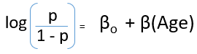
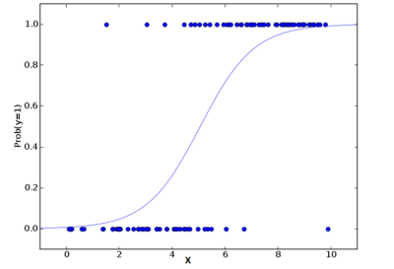
Logistic Regression
Logistic Regression is a classification algorithm. It is used to predict a binary outcome (1 / 0, Yes / No, True / False) given a set of independent variables. You can also think of logistic regression as a special case of linear regression when the outcome variable is categorical, where we are using log of odds as the dependent variable. In simple words, it predicts the probability of occurrence of an event by fitting data to a logit function

Slide 17
Logistic Regression
Bag-of-Words Features
F1 Score: 0.567
TF-IDF Features
F1 Score: 0.508
Word2Vec Features
F1 Score: 0.661

Slide 18
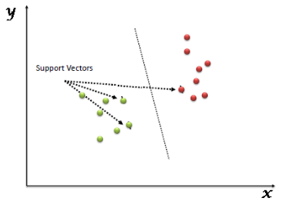
Support Vector Machine
Support Vector Machine (SVM) is a supervised machine learning algorithm which can be used for both classification or regression challenges. However, it is mostly used in classification problems. In this algorithm, we plot each data item as a point in n-dimensional space (where n is the number of features you have) with the value of each feature being the value of a particular coordinate. Then, we perform classification by finding the hyper-plane.

Slide 19
Support Vector Machine
Bag-of-Words Features
F1 Score: 0.654
TF-IDF Features
F1 Score: 0.676
Word2Vec Features
F1 Score: 0.694

Slide 20
XGboost
Extreme Gradient Boosting (xgboost) is an advanced implementation of gradient boosting algorithm. It has both linear model solver and tree learning algorithms. Its ability to do parallel computation on a single machine makes it extremely fast. It also has additional features for doing cross validation and finding important variables. There are many parameters which need to be controlled to optimize the model.

Slide 21
XGboost
Some key benefits of XGBoost are:
Regularization - helps in reducing overfitting
Parallel Processing - XGBoost implements parallel processing and is blazingly faster as compared to GBM.
Handling Missing Values - It has an in-built routine to handle missing values.
Built-in Cross-Validation - allows user to run a cross-validation at each iteration of the boosting process

Slide 22
XGBOOST
Bag-of-Words Features
F1 Score: 0.644
TF-IDF Features
F1 Score: 0.654
Word2Vec Features
F1 Score: 0.713

Slide 23
Our experiments on twitter sentiment analysis show that part-of-speech features may not be useful for sentiment analysis in the microblogging domain. More research is needed to determine whether the POS features are just of poor quality due to the results of the tagger or whether POS features are just less useful for sentiment analysis in this domain. Features from an existing sentiment lexicon were somewhat useful in conjunction with microblogging features, but the microblogging features (i.e., the presence of intensifiers and positive/negative/neutral emoticons and abbreviations) were clearly the most useful. Using hashtags to collect training data did prove useful. However, which method produces the better training data and whether the two sources of training data are complementary may depend on the type of features used. Our experiments show that when microblogging features are included, XGBOOST model performs well over Logistic Regression and SVM. XGBOOST efficiency will increases if we fine-tune the model along with word2vec.
This project addresses the problem of sentiment analysis in twitter;
SUMMARY
SUMMARY

Slide 24
Sentiment analysis or opinion mining is to study and analyzes people’s sentiments, attitudes, towards certain entities. Many big firms are practicing this feature to understand their product performance in new release market and making decisions to tackles fundamental problem/improvements which are need to be addressed by analyzing , sentiment expressed by people through their viable mediums (one such medium is Twitter).
This project addresses the problem of sentiment analysis in twitter;
CONCLUSION
SUMMARY

Slide 25

Slide Title
THANK YOU

